Slide 1
TECH1101: Web & Internet Fundamentals
Winter 2024
Michael Dorsey

Slide 2
Welcome to class
Land acknowledgement
About me
About you
Name
Where are you from?
Which diploma program are you in?
Career aspirations (if any)
Past experience:
HTML
CSS
JavaScript

Slide 3
Expectations
Attend each class
Be on-time.
Important announcements are at the beginning of class.
Come prepared to class
Read course materials before class. Have questions ready.
Complete all Learning Activities.
Bring a charged and working laptop computer.
Be engaged
Ask and answer questions.
Speak up.
Collaborate with classmates.
Respect for your classmates and the instructor
Silence all devices.
Laptops used for class purposes only.

Slide 4
Academic Honesty and Integrity
Plagiarism is not allowed.
Use proper citations for any outside material.
Collaborating with classmates is allowed for at-home assessments (e.g. GLAs, assignments).
But everyone must submit their own personal work.
Collaborating with classmates is not allowed for timed assessments (e.g. quizzes, exams).
Use of generative AI is allowed if its properly referenced. See the “AI Policy” for more details.

Slide 5
Technology and Communication
D2L / Brightspace
News and notices posted by the instructor
Course content
Assessments
Assignments
Submissions
Calendar
Email communication
Contact the instructor via email on D2L or MS Teams. Do NOT send an email to my Bow Valley College email address.

Slide 6
Technology and Communication
MS Teams
Used for quick communication
Channels:
General – used by instructor for general news about the course
Student Chat Room – where students can discuss any course-related topics

Slide 7
Course Specifics
Course Outline
Course Offering Information
Assignments Policy
AI Policy
Assessments Schedule
Class Slideshows
Notes:
ChatGPT example: In JavaScript, write me a function that produces a random number between 1 and 6.

Slide 8
Questions?

Slide 9
Lesson 1.1
A Simple HTML Document

Slide 10
Learning Outcomes
Explain HTML basics
Define the basic structure of an HTML document

Slide 11
What is HTML?
Hyper Text Markup Language is a markup language that tells web browsers how to structure a web page
Most basic building block of the web
Consists of a series of elements
Elements tell the browser how to display the content
Tags are used to define different types of elements
Opening: <…>
Closing </…>
Browsers do not display tags themselves
Notes:
CSS -> describes a web page’s appearance and presentation
JavaScript -> describes a web page’s functionality and behavior

Slide 12
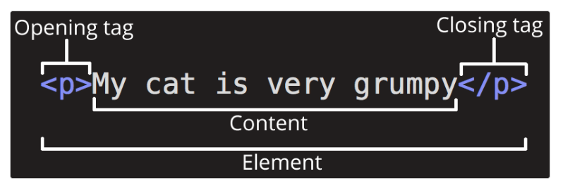
Anatomy of an HTML element
Notes:
Failing to include a closing tag is a common beginner error that can produce peculiar results.

Slide 13
Nesting elements
CORRECT:
<p>My cat is <strong>very</strong> grumpy.</p>
INCORRECT:
<p>My cat is <strong>very grumpy.</p></strong>

Slide 14
Void elements
Void elements are elements that consist of a single tag
Typically used to insert/embed something in the document
Examples:
<img>
<br>
<hr>

Slide 15
Learning Activity 1.1.1
Let’s Build Our First “Hello World” HTML Page
NOTE: the webpage you create is only accessible from your computer. It is not available on the internet.

Slide 16
For next class
Read Lesson 1.1, then do Learning Activity 1.1.1
Read Lesson 1.2
Create a CodePen account, then do Learning Activity 1.2.1
Install a code editor on your computer, then do Learning Activity 1.2.2
Assessments Reminder:
Engagement is worth 10% of your final grade. Engage by sharing code, asking or answering questions, etc.
All assessment dates have been posted in the D2L calendar.
See the “Assignments Policy” for late submission procedures.

